Slide 1



Serial Debuggers and bootloader security
Micah Flack

Slide 2
Learning Outcomes
Types of serial debug ports
UART
JTAG
Locate layouts
Identify board components
How to interface with devices
Understand least privilege principles

Slide 3
Security Principle – Least Privilege
The goal of least privilege is to limit the access of users or admins to an as needed basis.
This prevents potential attackers from gaining greater access to a system or services despite their originally intended permissions/status.
e.g., the average user of an online service shouldn’t have the same control as the admins

Slide 4
Security Principle – Least Privilege
For physical devices this can mean many things:
Hiding or locking access to physical components of the device
USB ports, printers, scanners, I/O...
BIOS settings to disable unneeded features
Could be CPU options used for virtualization or overclocking
Specifying boot options
Allowed I/O devices
Disabling serial debug access
Blocking output of shell

Slide 5
Least Privilege Examples
Good examples of least privilege adherence would be implementing security restrictions like:
BIOS admin passwords
Encrypting boot drives
Requiring a login at boot
Limiting permissions for critical services to specific accounts
A separate admin account with unique creds for each database

Slide 6
Least Privilege Examples
Bad examples of least privilege adherence would be implementing security restrictions like:
No BIOS password
Allowing unauthorized bootable media
Unprompted access to admin accounts
Not enabling authentication for services
Using the same account for multiple services that require admin access
Incorrect file permissions for sensitive files/directories

Slide 7
Least privilege and Physical security
As for how this relates to serial debuggers and their privileges, how often do you determine the level of serial access to any devices you use? If it were an IoT device used at home, you might create a separate vLAN for similar devices to limit access/visibility.
Other than locking the device in a room, how do you verify or limit serial access to the device?

Slide 8
What are Serial Debug Access Ports (DAP)?
A debug access port (DAP) is a chip-level diagnostic interface tool used to directly communicate with the CPU or microcontroller.
With the correct hardware, an operator can use a debugger like GDB to halt the chip and manually troubleshoot any code running on it.
In some instances, if the debugged device were running something like RTOS (a lightweight embedded OS) they could debug the firmware running directly on the processor within Eclipse development tools.

Slide 9
Serial DAP
Typically, to interface with any serial DAP, we to least identify:
TDO/RX: trace used for receiving instructions
TDI/TX: trace used for transmitting instructions
VCC: either to supply power or reference board voltage
Commonly either 3.3V or 5V
GND: any trace used for ground
Each format is different and you to verify before interfacing.
Common formats are:
JTAG/UART/SWD/OBD/CANBUS

Slide 10
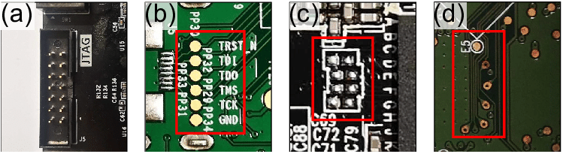
JTAG LAYOUT EXAMPLEs

Slide 11
Identifying DAP Interfaces
In the previous slide we showed examples of different JTAG layouts. However, there might be some instances where the ports are unlabeled or mismatching.
One method we can use is to consult the chipset manufacturer datasheet.
With the manual we can identify pinouts on the chip and then use the continuity function of a multimeter map the chip pins to groups of unlabeled traces.

Slide 12
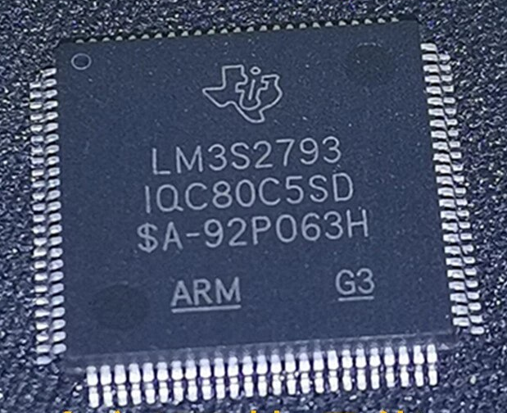
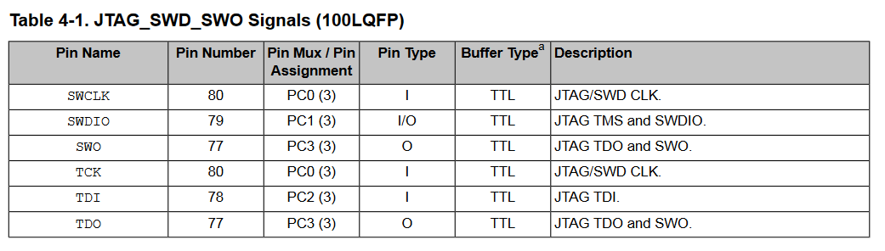
Chipset Identification
For example, if the we look at this image…. We can identify that the chipset serial number is LM3S2793 from Texas Instruments.
The datasheet for the chip then shows us the corresponding pin numbers:

Slide 13
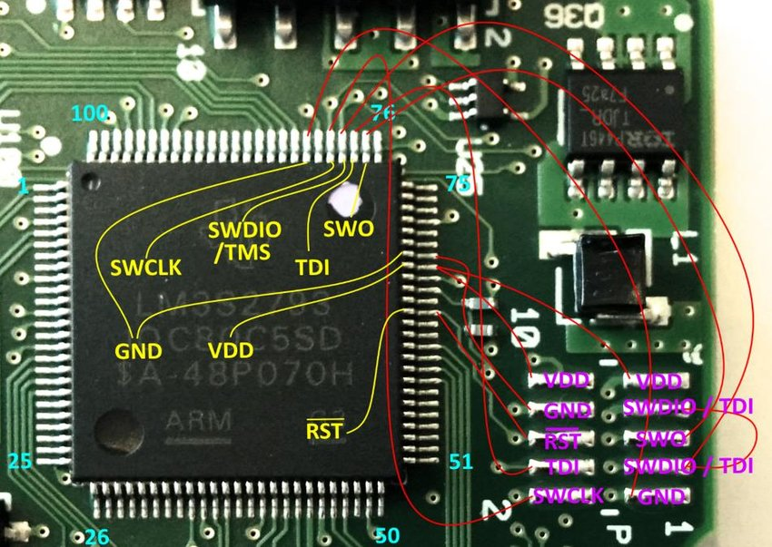
Mapping JTAG PINS
The result of mapping those pins to an unlabeled group of traces should look something like the following image.
SW* terms can be ignored for now (these are used for SWD).
Although time consuming, it is much cheaper than using an x-ray machine – I promise.

Slide 14
Connecting to the JTAG Interface
Connecting to the interface is relatively simple, we just need to create a wire harness that our tools can use. You will need to connect a wire to each trace used by the JTAG port.
You might need to request help from someone with knowledge of soldering.
If that is not available, you can try the following options:
Alligator clips
Hot glue
Electrical tape

Slide 15
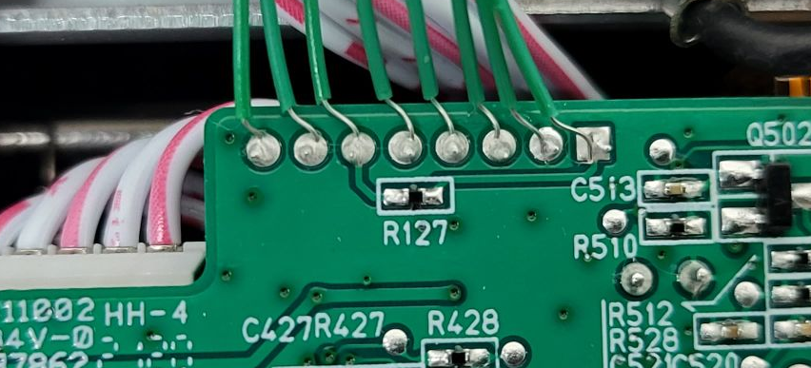
Example of JTAG HARNESS

Slide 16
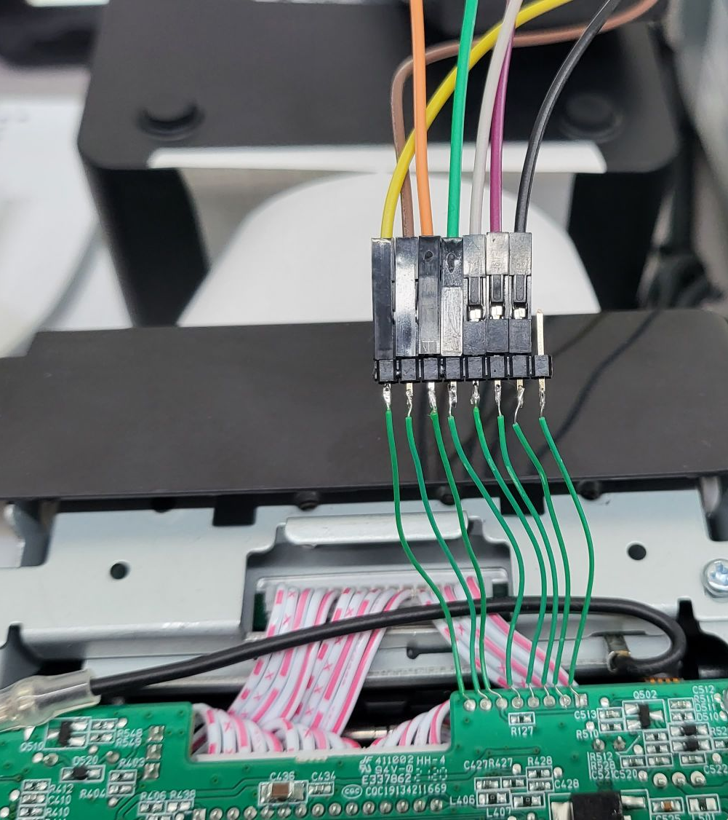
Example of JTAG HARNESS – Cont’d
Color coding the harness is especially helpful for keeping track of which wire is used for what pin of the JTAG port.
WARNING: If you mismatch the GND or VCC with any other JTAG pin, it will cause irreversible damage.

Slide 17
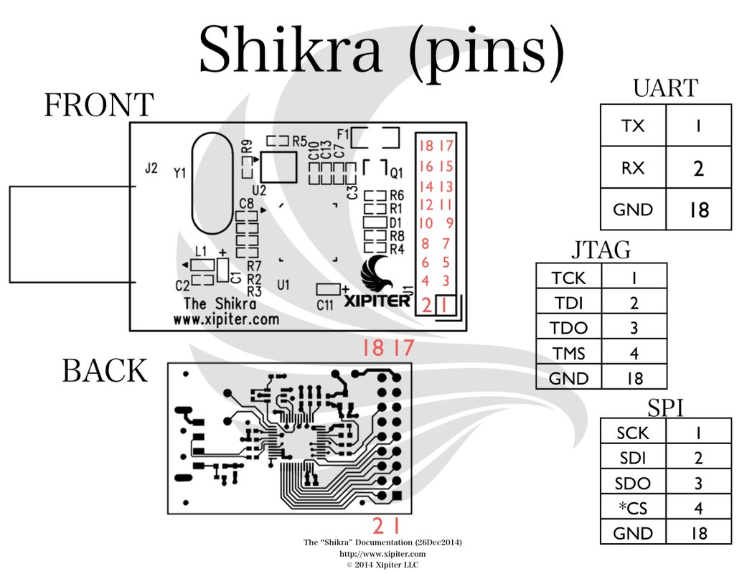
Using Serial debugger devices
Shikra (or whatever alternative) should be wired to the target device before connecting to computer.
Once connected, you should see the following devices appear:
Windows
Device Manager > Ports (COM & LPT)
Should see something like “COM1”
Linux
sudo dmesg | grep ttyUSB0
Should see some output showing the device was connected and registered to ttyUSB#

Slide 18
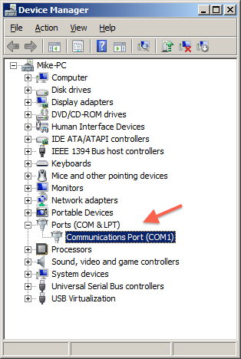
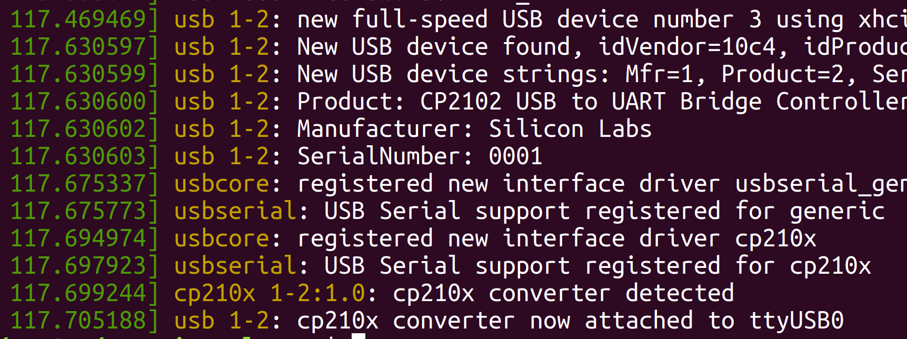
Debugger Device Connection

Slide 19
Connecting to Debugger - Ubuntu
Install the tools if not already:
sudo apt install minicom –y
Connect to the debugger:
sudo minicom –D /dev/ttyUSB0
You can also use the following command and configure minicom your way:
sudo minicom -s

Slide 20
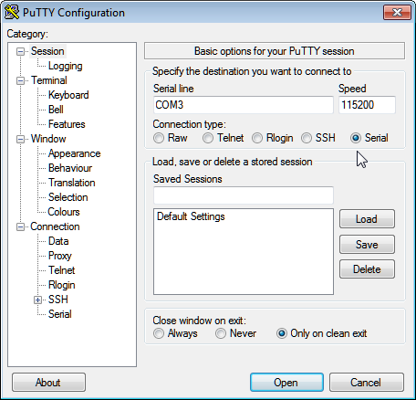
Connecting to Debugger - Windows
Download and install PuTTY.
Connect to the debugger using these settings:
Serial line: COM1
Or whatever device manager showed
Speed: 115200
Conn. Type: Serial
Click ‘Open’.

Slide 21
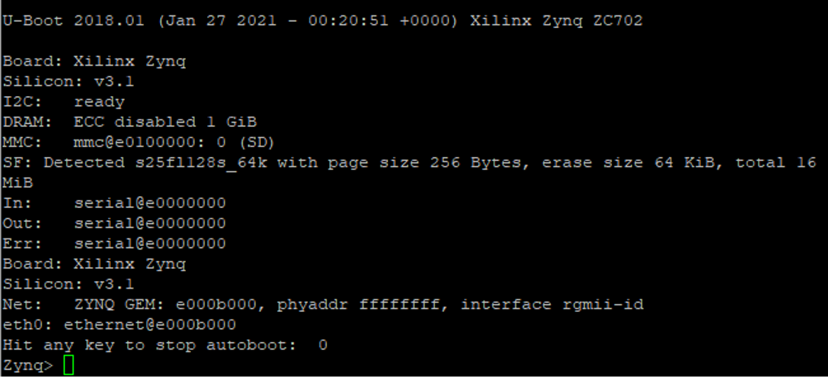
Successful serial access

Slide 22
Expected outcome
In many cases, serial debugger access is still enabled to allow:
post-production patches to the firmware
faulty device debugging
user modding
However, in sensitive cases like critical infrastructure or equipment whose confidentiality needs to be guaranteed – this should be disabled to limit access and prevent tampering.

